Slide 1

Gravitational waves
DEPARTMENT OF PHYSICS
Submitted by:
Lakshita Jain
24205001113
Submitted to:
Dr. Rajnish Kurchania
Head of Department of Physics

Slide 2
Content:-
Abstract
Introduction
Timeline
Types of Gravitational waves
Detection Methods
Insights of GW
Limitation and challenges
References

Slide 3
Abstract :-
Gravitational Waves are ripple or vibrations in space time which can effect space and time coordinates.
These waves are produced by some of the most violent and energetic process in the space.
These ripples are travel with the speed of light and carrying information about their origins, as well as hint to the nature of gravity itself.
These waves are not visible; feel the affect of these waves are too crucial for detecting them there are some ground base detectors are present from the ground like: LIGO (Leaser Interferometer Gravitational-waves Observatory), VIRGO and KAGRA(Kamioka Gravitational Wave Detector) and one is for the earths orbit LISA( Leaser Interferometer Space Antenna ) at the present time other than natural detector.
Ref: [1,7]

Slide 4
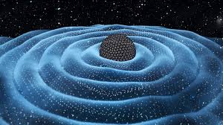
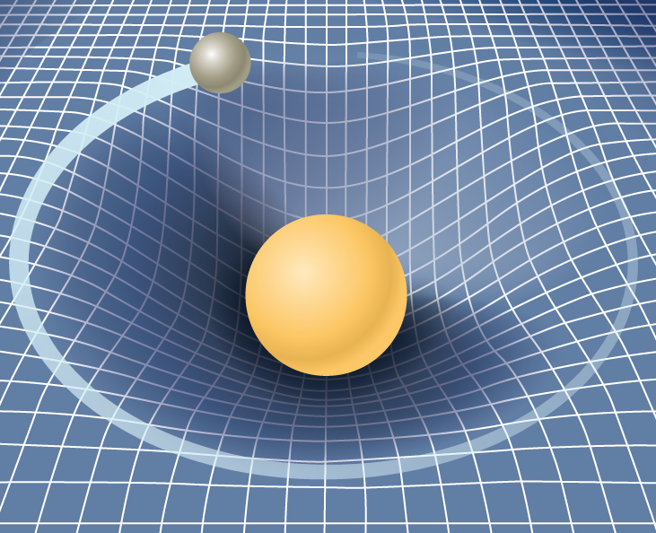
Introduction:-
Einstein's 1916 General Theory of Relativity firstly gives the concept of gravitational waves(GW) by conclusion i.e. the force of gravity arises from a warping of spacetime around a body of matter ; and his mathematics also showed the how these will propagates.
Heavily massive object decide how the shape space-time curve and space time curve decides how mass will move.
Ref: [2]

Slide 5
Timeline:-
1957
Felix Pirani, Hermann Bondi and Richard Feynman predict that GW might be detected by a sticky brad argument.
1962
Russian scientist ME Gertsenshtein and VI Pustovoit published a paper proposing interferometer as a way to detect GW
1967
Rainer Weiss also propose a similar concept to detect GW.
1974
Rainer Weiss and physicist Kip Thorne worked on the project that would become LIGO.
1978
Russell Hulse and joseph Taylor provide the first experimental evidence for the existence of GW by observing two neutron stars obverting each other.
1990s-2001-2010
1990s begins construction of LIGO and 2001 LIGO begins operation at the end of its 2010 had found that LIGO worked but need more sensitive.
2007
The VIGRO laser interferometer based in Italy designed to detect GW begins operation
2010-14
LIGO goes offline for upgrades meant to increase its range 10 times farther out into the universe.
September 14, 2015
In LIGO detects GW for the first time, proving Einstein's General theory of Relativity. These waves were caused by collision of two Black holes.
June 2020
Aug 17, 2017
Dec 26, 2015
Jan 4 -Aug 14, 2017
There were first and second detection of GW caused by black hole colliding with a neutrino star.
LIGO detects GW caused by two Neutron stats colliding, this is the first- ever multi-messenger discovery.
LIGO detected GW again caused by two black holes.
VIGRO AND LIGO detected GW cause by two black holes.
LISA pathfinder is launched- a test based mission for the first space based GW detector.
Ref:[7]

Slide 6
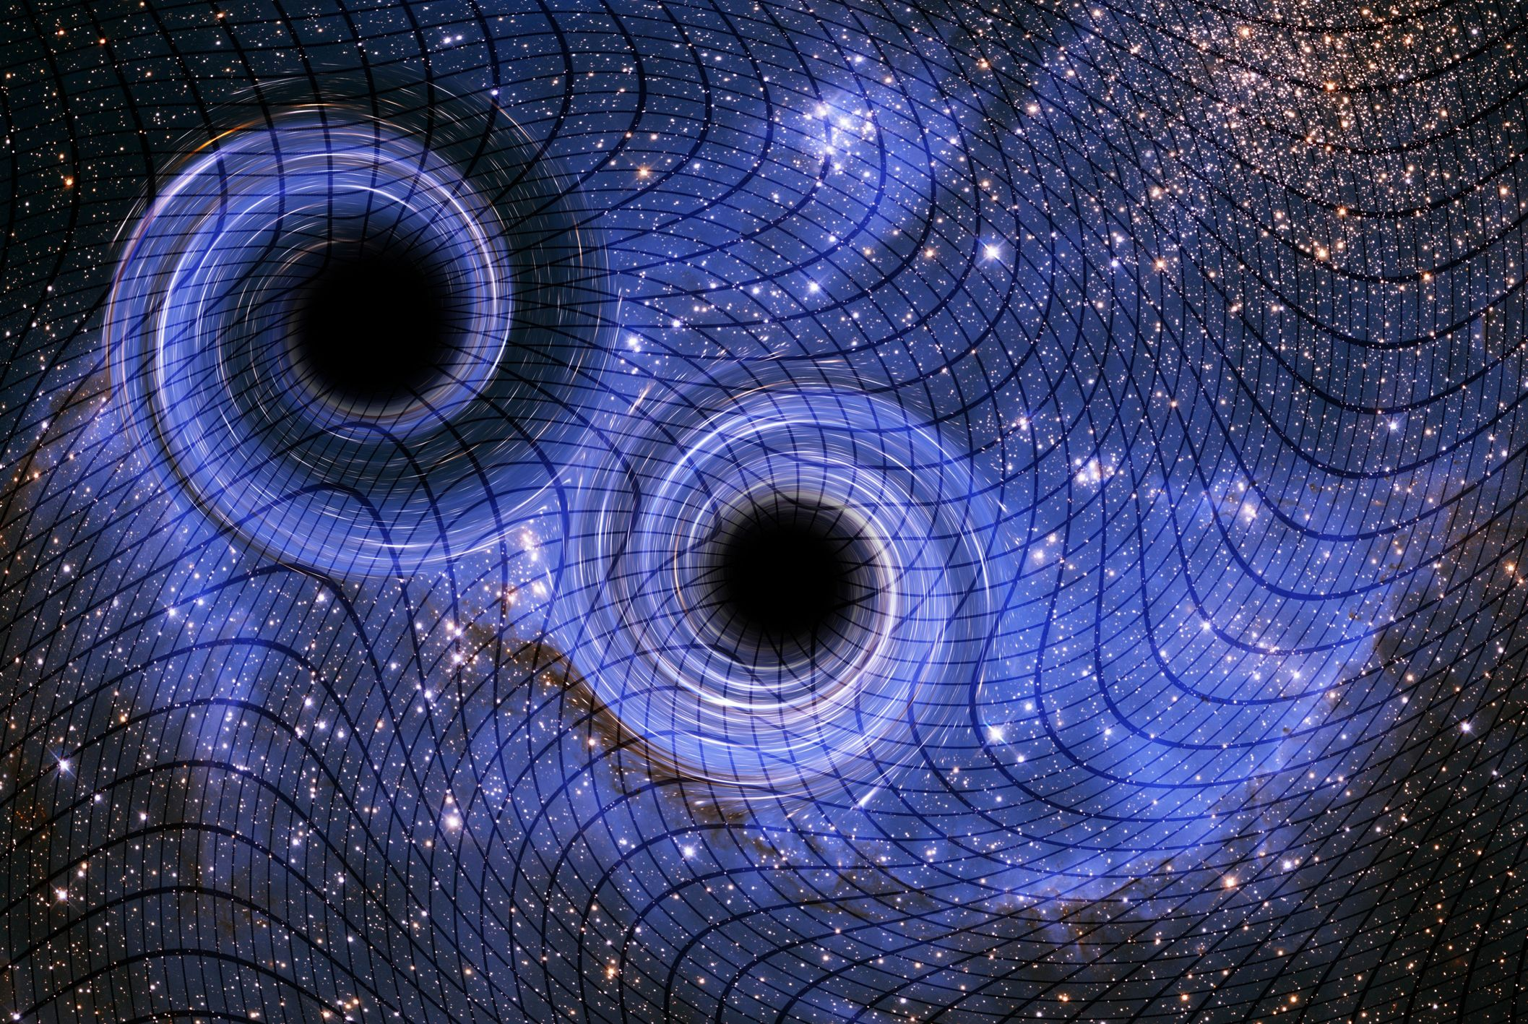
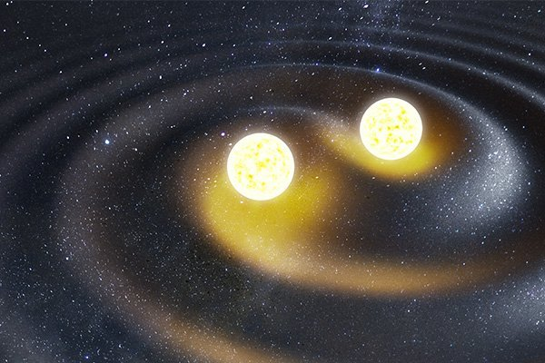
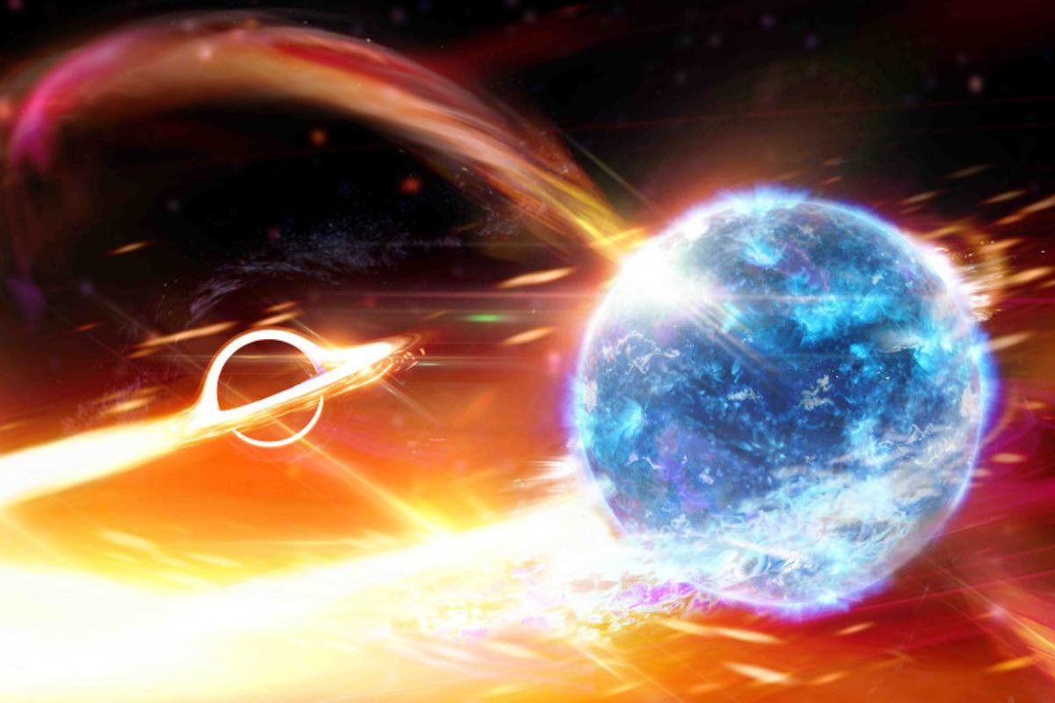
Types of gravitational waves and their generation
.
1.Compact binary spiral GW
a) Binary Black Holes
b) Binary Pulsars
c) Binary motion of pulsar and a black hole
Ref: [1]

Slide 7
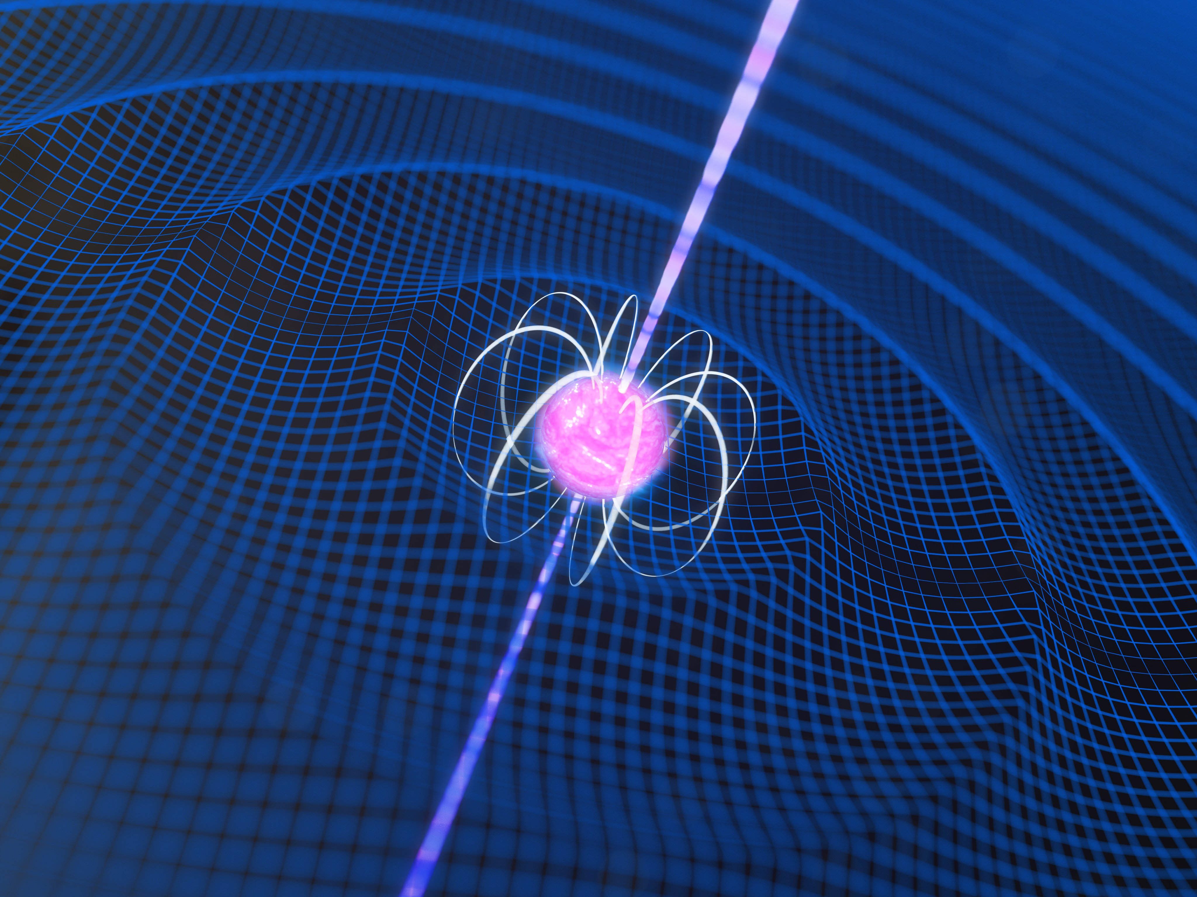
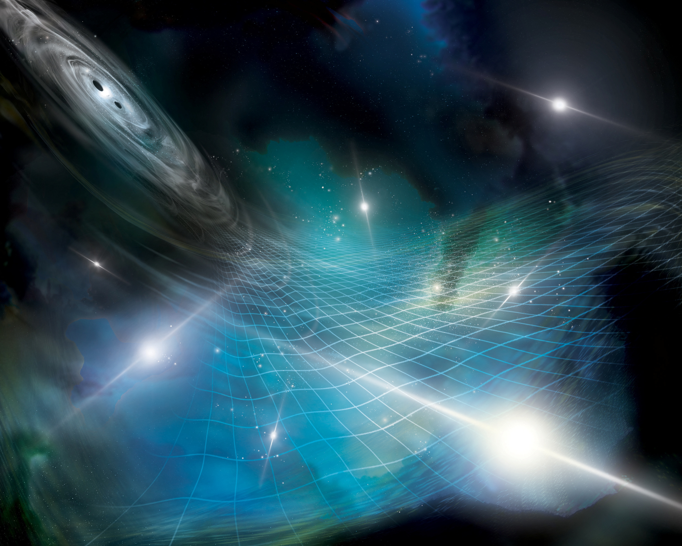
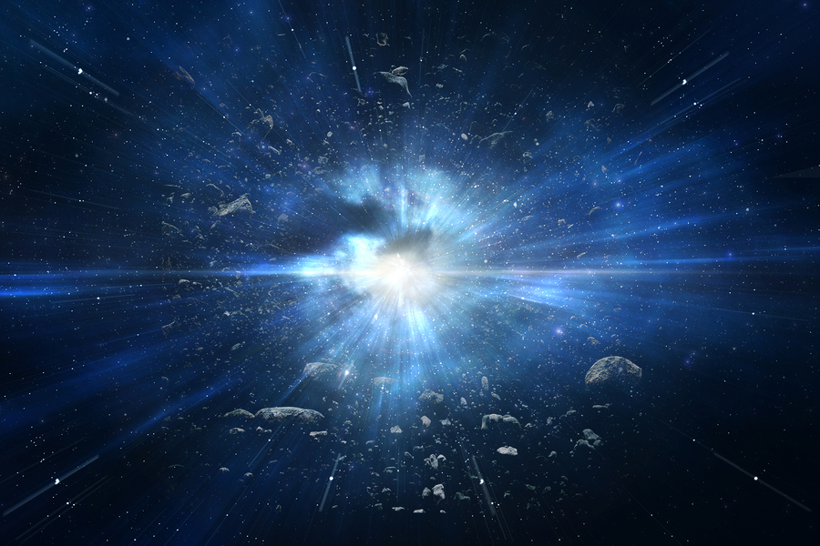
2. Continuous Gravitational Waves
3. Stochastic Gravitational waves
4. Brust Gravitational Waves
Ref: [1]

Slide 8
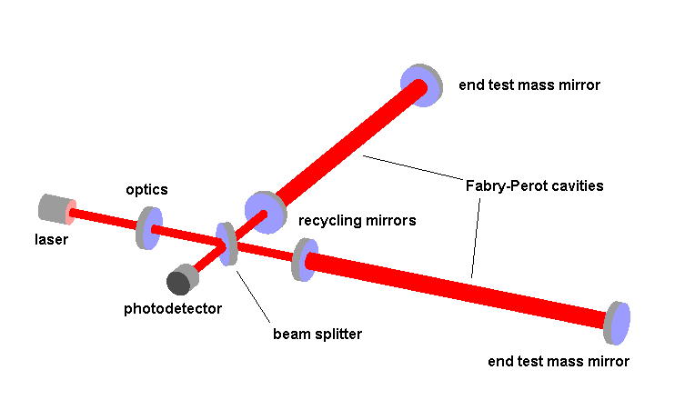
Detection methods
LIGO
VIRGO
KAGRA
LIGO has 4 km long arms where as VIRGO has 3km long arms and they both have optical mirrors where as KAGRA has 3km long arms with cryogenic sapphire mirror but all three are working on the Michelson interferometers principle
Ref: [1,3,4,]

Slide 9
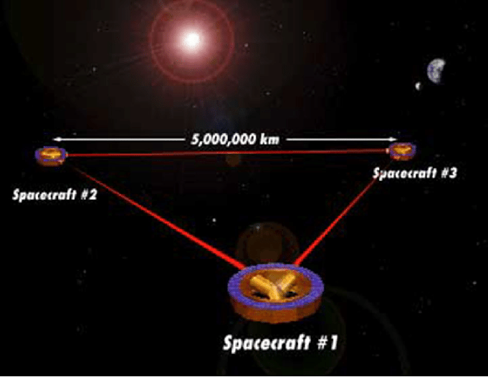
4. LISA
LISA is the first space-based interferometry. Thee are three spacecraft which make an equilateral tringle in space and path between each pair will be taken as LIAS’s arm. It orbits the Sun as behind the Earth( as like tail) .
Ref: [5,6]

Slide 10
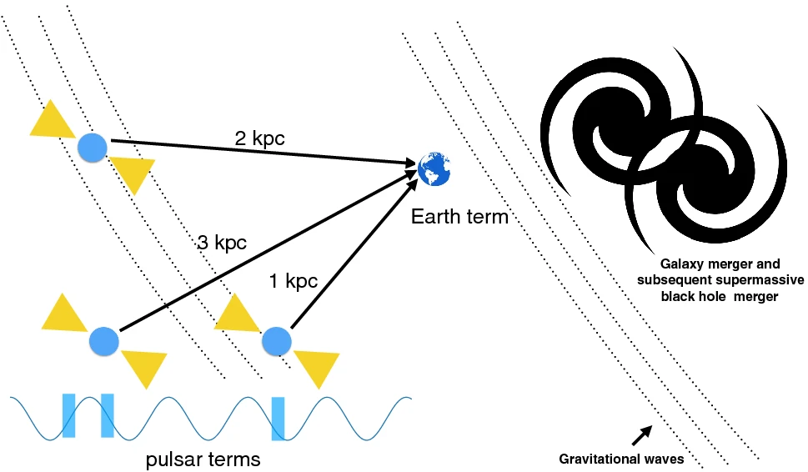
5. PTA
PTAs are networks of highly stable millisecond pulsars observed over long periods. Gravitational waves passing between Earth and pulsars cause tiny shifts in pulse arrival times, allowing detection of low-frequency gravitational waves from massive astrophysical sources.
Ref: [10]

Slide 11
Insights from GW
Information about the source of the GW like: mass, spin, distance from the detector etc.
Its observation of binary neutron star merging gives the information of formation of the core of a neutron star.
It gives the equation of sate of super neutron matter by the constrain of tidal deformability of neutron star.
It helps to measure the rate of cosmic expansion.
Gives the concept of gravitational friction.
It might also contain the information of birth of the universe .
And might be many more unknown information about the space.
Ref: [5,6,7,8,9]

Slide 12
Limitation & challenges
Amplitude of GWs are too small hence its very hard to detect all the GWs.
At low frequencies, ground-based detectors are limited by seismic noise and other environmental vibrations.
Creaks in mechanical structures, lightning, or other large electrical disturbances can create noise that masks or imitates an event.
In present there most sensitive detector is LIGO has range 5Hz to 20,000 Hz but above mention problem reduce the sensitivity.
Space based detector might be faced difficulties due to solar storms.
Spaced based detectors are quite costly.
Ref: [1,4,5,8]

Slide 13
Reference:
LIGO-Gravitational Waves https://www.ligo.caltech.edu/page/what-are-gw
Alfred Engel; The collected Papers of Albert Einstein, volume 6 The Berlin Years; Writing, 1914-1917 ,volume 6 ,page 449; https://einsteinpapers.press.princeton.edu/vol6-trans/
Nicolas Arnaud ; LIGO and VIGRO detector characterization and data Quality, vol1048, year 2023; https://www.sciencedirect.com/science/article/pii/S0168900222012372
ICRR The University of Tokyo; What is GW, KAGRA Project https://www.icrr.u-tokyo.ac.jp/gr/GWPOHPe/whatgw-e.html
LISA- NASA; https://lisa.nasa.gov/

Slide 14
Elizabeth Gibney ; ‘Sci-fi instrument’ will hunt for giant gravitational waves in spaces , news 2024 https://www.nature.com/articles/d41586-024-00254-x
Keith Riles ; Search of Continuous-Wave Gravitational Radiation; vol.26, year 2023 https://www.nature.com/articles/s42254-022-00420-y#peer-review
Alexandra Witze; LIGO live: Inside the hunt for Gravitational waves; year2016 https://www.nature.com/articles/nature.2016.19344
Souvik Jana, Shasvath J. Kapadia, Tejaswi Venumadhav and Parameswaran Ajith;; Cosmography using strongly Lensed Gravitational Waves from Binary Black Holes; vol.130, year 2023 https://journals.aps.org/prl/abstract/10.1103/PhysRevLett.130.261401
The European Pulsar Timing Array- EPTA; https://www.epta.eu.org/gravitational-waves.html

Slide 15
Any query

Slide 16
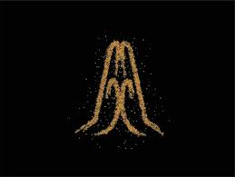
THANK YOU

